Slide 1

片上系统的内部互连
—AMBA AXI 协议
分享人：王旭升
2023年5月9日

Slide 2
Introduction
片上系统的内部互连一般指处理器核(CPU)和各片内外设的互连。对于我们遇到的开发任务，处理器核可以是某种硬核(例如ZYNQ中的PS端)，也可以是使用FPGA内逻辑资源构建的软核(MicroBlaze、XDMA bridge)，外设可以是各类IP（DDR控制器、DMA控制器、HLS导出的IP）等。
在Xilinx的FPGA/ZYNQ产品中，AMBA AXI协议得到广泛使用和支持。Xilinx提供了AXI的一系列基础设施（Vivado中的相关IP核、HLS中的相关接口约束）来加速开发。
The Arm Advanced Microcontroller Bus Architecture, or AMBA, is an open-standard, on-chip interconnect specification for the connection and management of functional blocks in system-on-achip (SoC) designs.
AMBA协议定义了片上系统中各功能模块间是如何进行数据交互的。片上系统中的功能模块可以包括：多个CPU核、专用计算单元、控制器和外设。
AMBA协议不断发展演进，应用领域远远超出了微控制器的范畴，已经广泛用于IoT设备、智能手机中处理器的设计，并逐渐开始用于片上网络(NoC)系统的设计。

Slide 3
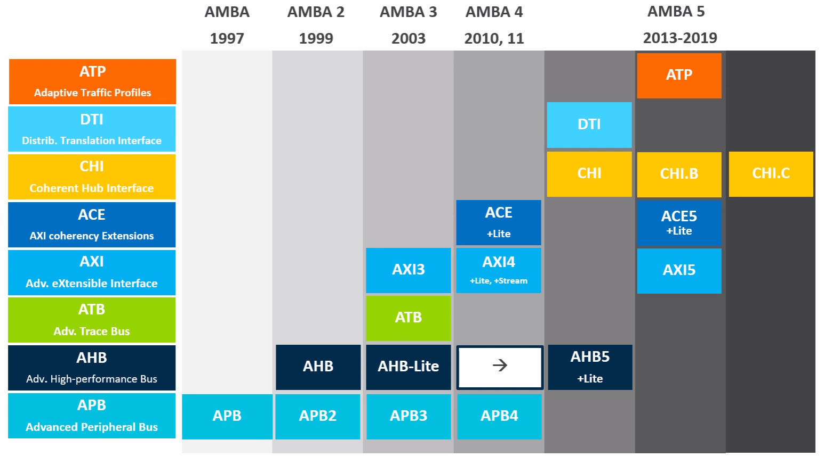
AMBA evolution
APB（Advanced Peripheral Bus）：用于对外围设备的控制信号访问，适于低带宽场景
AHB（Advanced High Performance Bus）：每个事务包含一个地址阶段和一个序列化的数据阶段，支持事务的流水化
AXI（Advanced eXtensible Interface）：五个独立的通道，支持读写并行，数据位宽最高可达1024，更高的数据传输带宽
AXI-lite：AXI的简化版，突发长度固定为1，不支持窄传输，数据位宽为32或64
AXI-Stream：面向高速数据流的传输，不涉及内存地址，数据位宽最高可达1024
ACE（AXI Coherency Extensions）：在AXI的基础上定义了一致性协议的状态、通道、事务类型、互连组件行为等
CHI（Coherent Hub Interface）：ACE的演进版，专为一致性设计的分层协议，更加灵活，易于拓展，用于更大规模的互连系统

Slide 4
Comparison
协议 | APB | AHB | AXI | AXI-lite | AXI-stream
数据位宽 | 8, 16, 32 | 32, 64, 128 | 8, 16, 32, 64, 128, 256, 512, 1024 | 32/64 | 8, 16, 32, 64, 128, 256, 512, 1024
地址位宽 | 32 | 32 | 32/64 | 32/64 | -
通道特性 | 读写地址通道共用 读写数据通道共用 | 读写地址通道共用 读写数据通道共用 | 读写地址通道独立 读写数据通道独立 | 读写地址通道独立 读写数据通道独立 | 单通道 （Tx -> Rx）
互连结构 | 单主多从 无仲裁 | 多主多从 有仲裁 | 多主多从 有仲裁 | 多主多从 有仲裁 | 多主多从 无仲裁
数据协议 | 每个传输占2个周期 不支持突发 | 支持流水传输 支持突发传输 支持乱序访问 | 支持流水传输 支持突发传输 支持乱序和交织 支持窄传输 支持写字节掩码 支持非对齐操作 | 支持流水传输 不支持突发传输 不支持乱序和交织 不支持窄传输 支持写字节掩码 | 任意突发长度 不支持流内乱序 支持流间的交织 支持写字节掩码
链路模式 | 半双工 | 半双工 | 全双工 | 全双工 | 单工

Slide 5
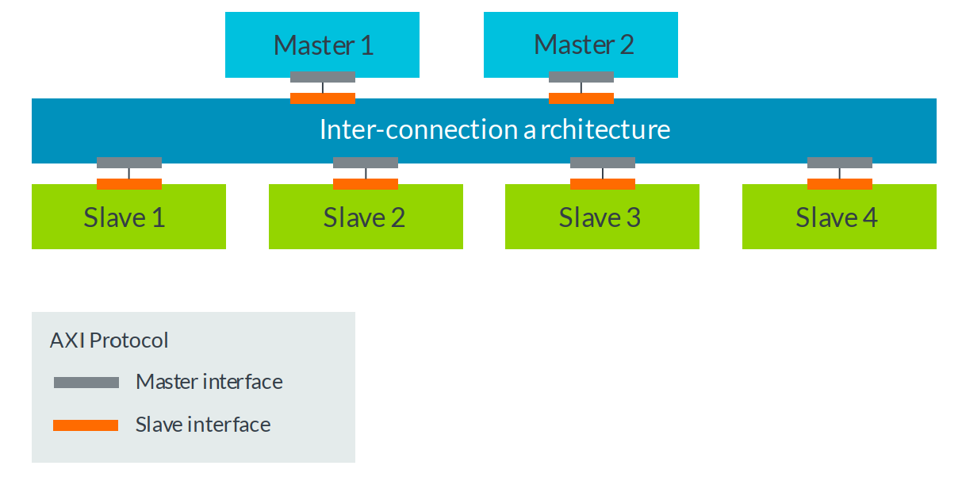
Multi-master & Multi-slave
一个简单的片上系统组成（多主多从），图中的Master可以是ARM Core，Slave可以是DDR controller；
AXI协议只定义主机和从机的点对点通信的信号和时序，更具体的说是定义了主接口和从接口间通信的信号和时序；AXI协议是
当系统中有多个主机和多个从机时，需要一个互连节点interconnect；interconnect具有多个主接口和从接口；
当每条点对点路径上的通信都满足AXI协议的规定时，整个系统就是基于AXI的(AXI based)。

Slide 6
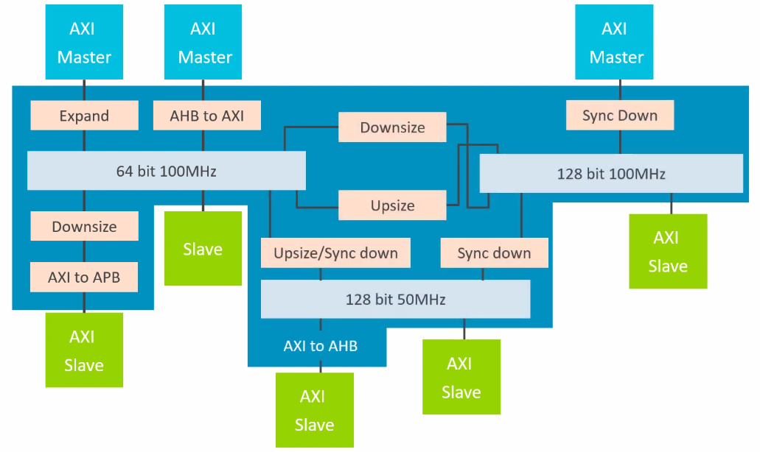
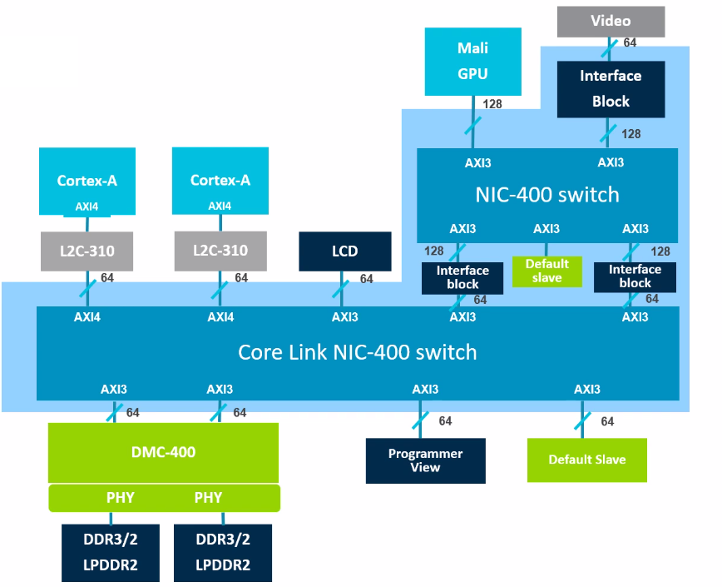
Interconnect
一个Interconnect的可能包含的功能有：
多从机路由：根据地址确定应收到请求的从机
读数据重排： 按保序要求对来自不同从机的数据重排序
多主机仲裁：决定能实际发出请求的主机
协议转换：AXI4<->AXI3、AXI<->AHB、AXI<->AXI-lite
位宽转换：主从间位宽不一致，需要Upsize、Downsize
时钟域转换：主从间时钟域不一致，需要异步FIFO暂存事务数据

Slide 7
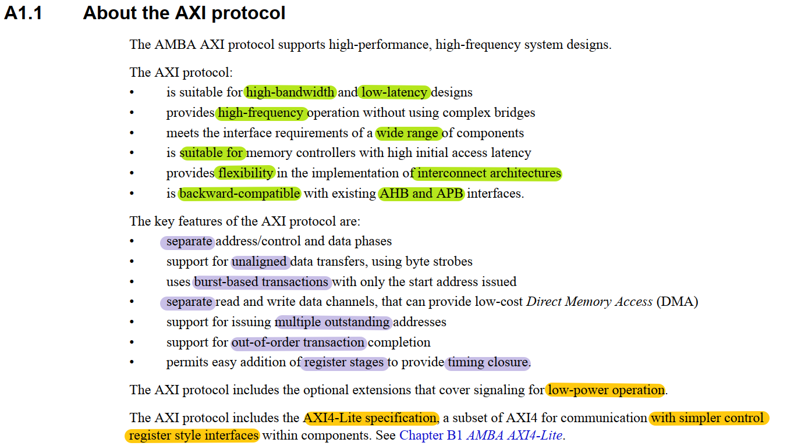
AXI features

Slide 8
Main AXI features
Independent read and write channels
AXI supports two different sets of channels, one for write operations, and one for read operations. Having two independent sets of channel helps to improve the bandwidth performances of the interfaces. This is because read and write operations can happen at the same time.
Multiple outstanding addresses
AXI allows for multiple outstanding addresses. This means that a master can issue transactions without waiting for earlier transactions to complete. This can improve system performance because it enables parallel processing of transactions.
No strict timing relationship between address and data operations
With AXI, there is no strict timing relationship between the address and data operations. This means that, for example, a master could issue a write address on the Write Address channel, but there is no time requirement for when the master has to provide the corresponding data to write on the Write Data channel
Support for unaligned data transfers
For any burst that is made up of data transfers wider than one byte, the first bytes accessed can be unaligned with the natural address boundary. For example, a 32-bit data packet that starts at a byte address of 0x1002 is not aligned to the natural 32-bit address boundary.
Out-of-order transaction completion
Out-of-order transaction completion is possible with AXI. The AXI protocol includes transaction identifiers, and there is no restriction on the completion of transactions with different ID values. This means that a single physical port can support out-of-order transactions by acting as several logical ports, each of which handles its transactions in order.
Burst transactions based on start address
AXI masters only issue the starting address for the first transfer. For any following transfers, the slave will calculate the next transfer address based on the burst type.

Slide 9
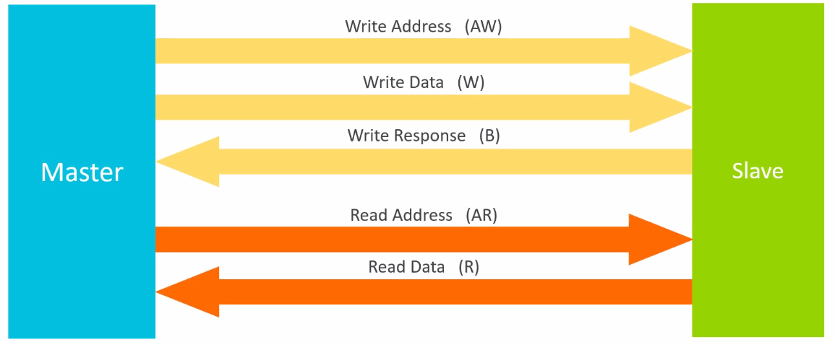
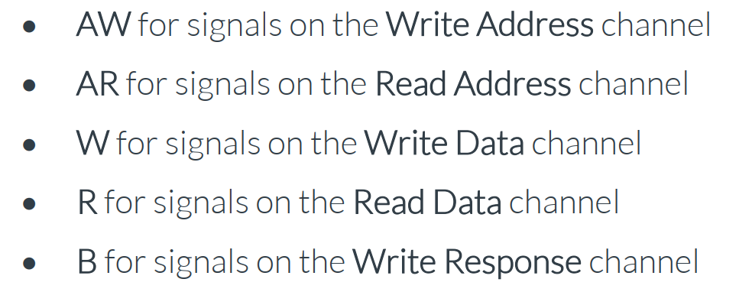
AXI channels
写操作涉及 AW、W、B三个通道：
主机在AW通道上发送写地址，在W通道上发送写数据
从机将接收到的数据写入特定地址，完成后在B通道上给出写响应
读操作涉及AR、R两个通道：
主机在AR通道上发送读地址
从机在R通道发送读数据(主机所请求地址的数据)
注意：
B代表“buffered”，因为写响应总是等所有数据都接收完毕才发出。
每个通道的传输方向都是单向的，因此需要一个单独的B通道到传输写响应；但没有的读响应通道，读响应合并在R通道传输
通过读写独立、地址与数据独立的方式，能够进行全双工通信，且允许多个在途事务，能实现传输带宽的最大化

Slide 10
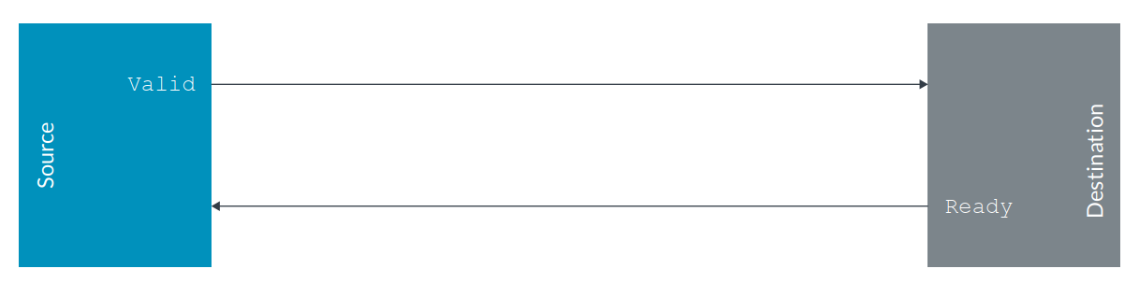
Channel handshake
缓冲区反压（Buffer Backpressure）
一般的系统设计中不能丢弃数据，因此必须有缓冲区反压机制来进行流控。当下游没有可用的缓冲区时，就不能继续传输数据。两种常用的反压机制：
基于信用（credit-based）： Source端维护的信值用（credits）记录了Destination可用的缓冲区数量。当Destination中的buffer被空出时，向Source发出信号增加该计数值。当Source发出数据时，自行减少该计数值。
开关信号（on/off signaling）：当缓冲区的数量或容量低于阈值时，该信号被设置，以阻塞上游的发送。
每个通道上的信息（地址、数据、响应 ）的传输都基于相同的Valid-Ready握手机制。
Source置高Valid表明发出的信息有效。Destination置高Ready表明可以接收信息。
Valid一旦置高，直到成功握手前都必须保持（sticky）；Valid和Ready同时置高的cycle上发生了数据传输。
注意与Master和Slave的概念不同。Source指的是该通道上的发起方，Destination指的是该通道上的接收方。例如Master在AR、AW、W通道上充当Source的角色，而在R、B通道上充当Destination的角色。

Slide 11
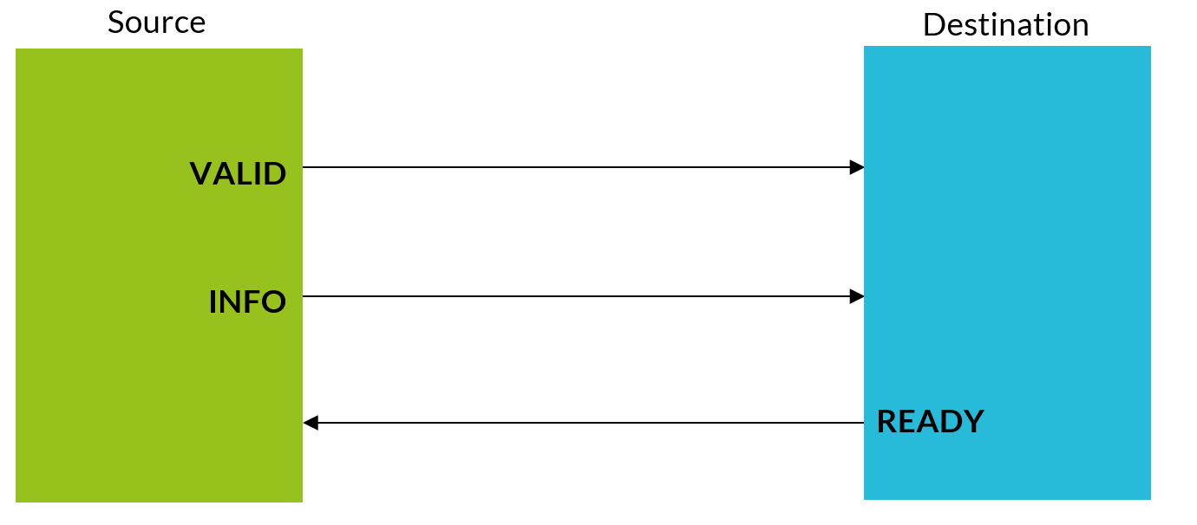
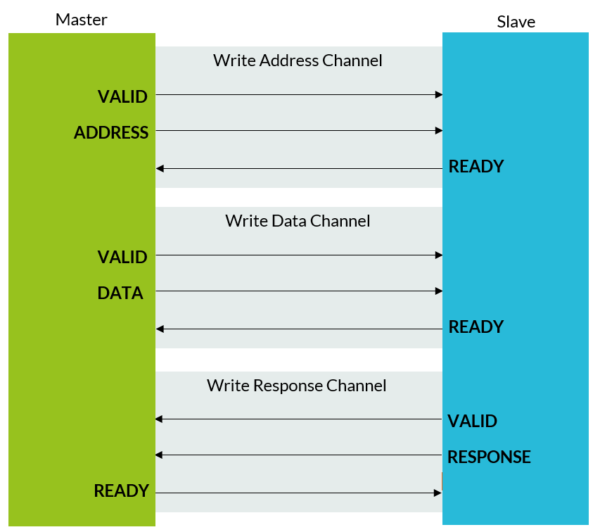
transfer vs. transaction
A transfer is a single exchange of information, with one VALID and READY handshake.
A transaction is an entire burst of transfers, containing an address transfer, one or more data transfers, and, for write sequences, a response transfer.

Slide 12
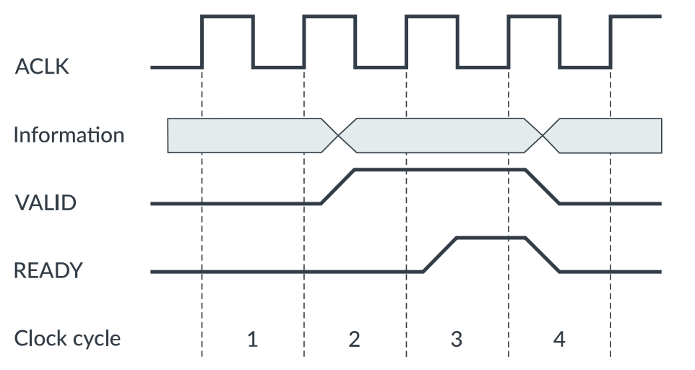
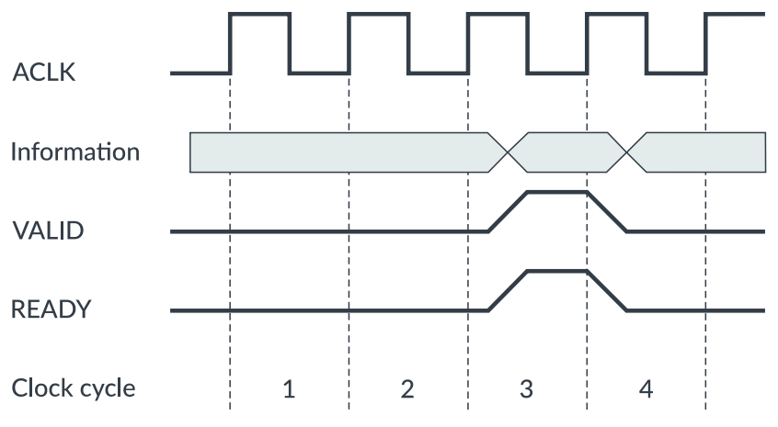
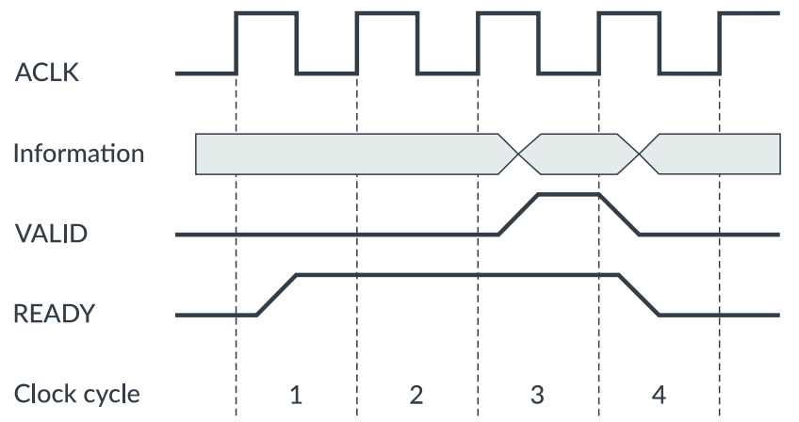
Channel transfer examples
Valid先，Ready后
Valid和Ready同时置高
Ready先，Valid后
各通道上的握手均需要满足下列原则：
对于Source，置高Valid时不能依赖Ready
对于Destination，置高Ready时可以依赖Valid

Slide 13
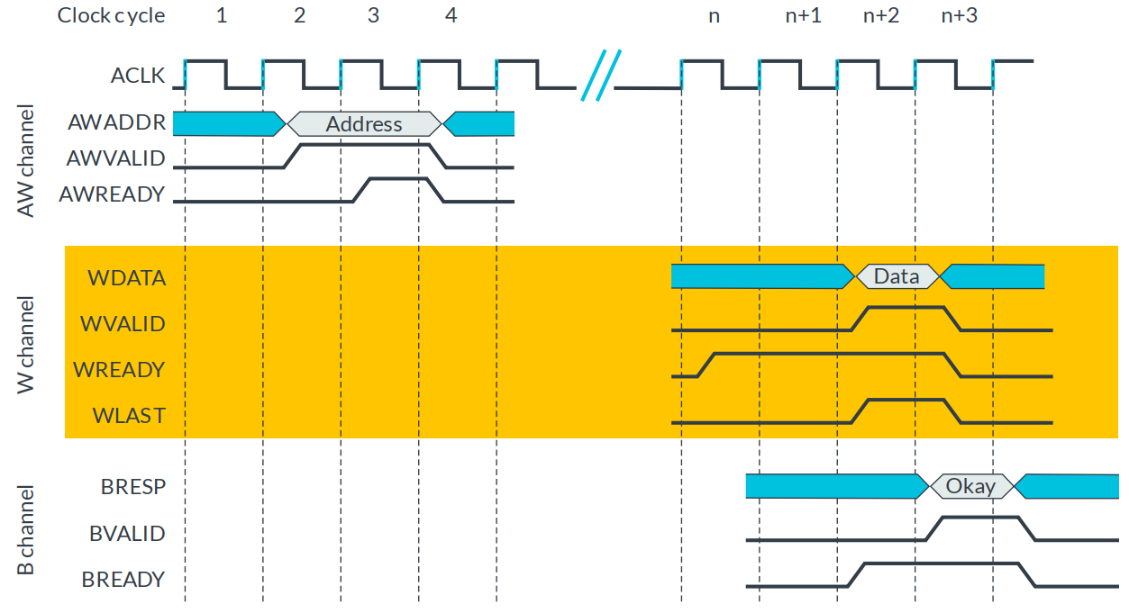
Write transaction: single data item
cycle 4：Master send request on AW
cycle n+3： Master send data on W
cycle n+4：Slave send response on B

Slide 14
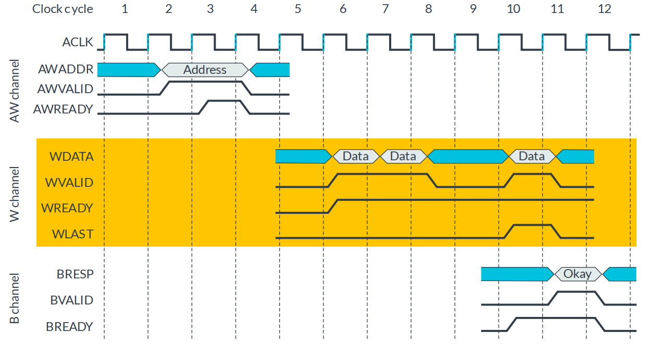
Write transaction: multiple data items
cycle 4：Master send request on AW
cycle 7,8,11： Master send data on W
cycle 12：Slave send response on B

Slide 15
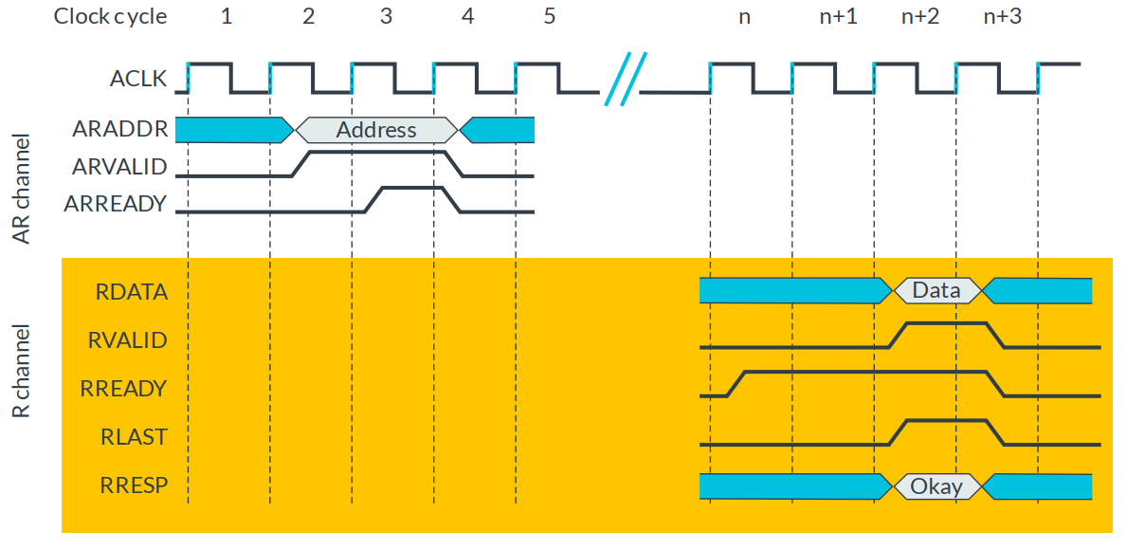
Read transaction: single data item
cycle 4：Master send request on AR
cycle n+3：Slave send data and response on R

Slide 16
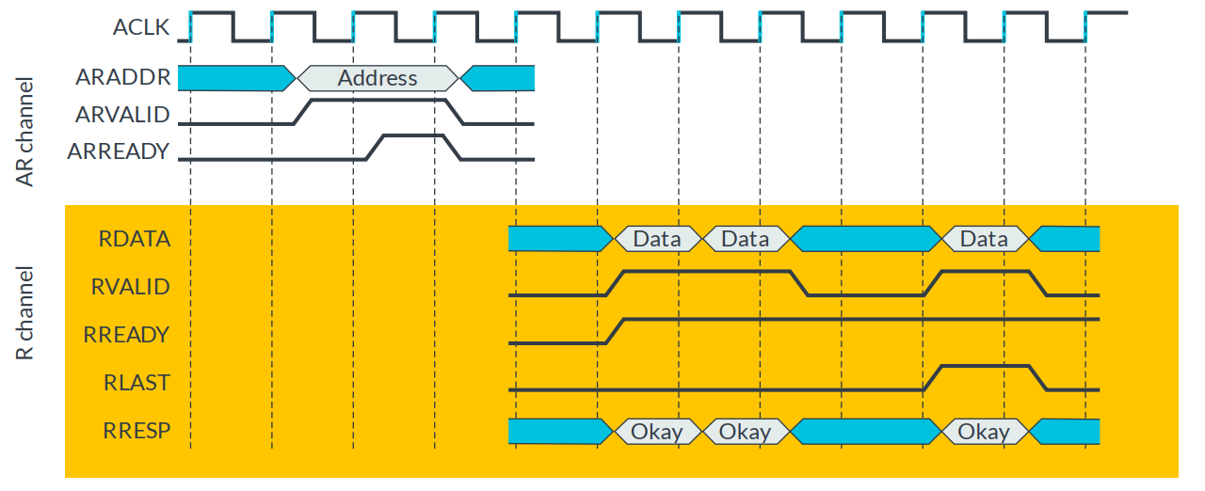
Read transaction: multiple data items
cycle 4：Master send request on AR
cycle 7,8,11：Slave send data and response on R

Slide 17
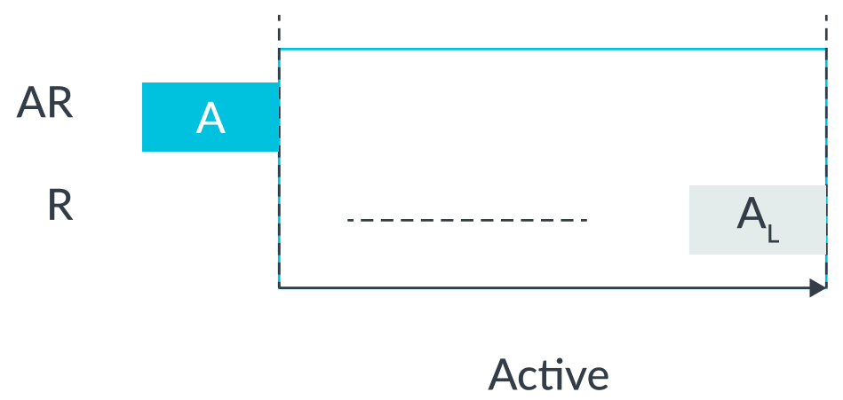
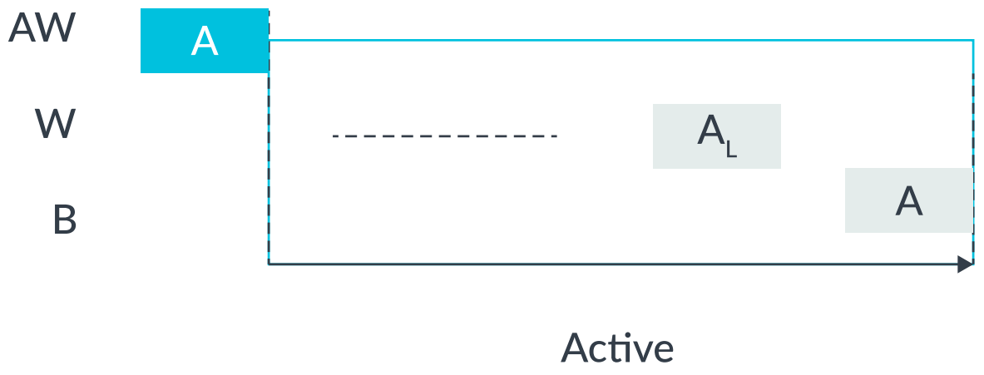
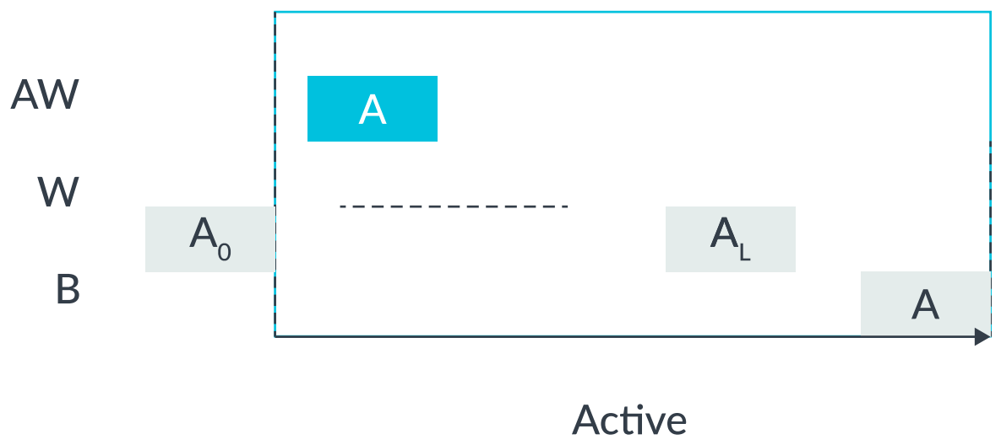
Outstanding transactions
Active transactions are also known as outstanding transactions.
With reads, the data must come after the address, so there is a simple reference point for when thetransaction starts.
An active read transaction is a transaction for which the read address has been transferred, but the last read data has not yet been transferred at the current point in time.
For write transactions, the data can come after the address, but leading write data is also allowed. The start of a write transaction can therefore be either of the following:
The transfer of the write address
The transfer of leading write information

Slide 18
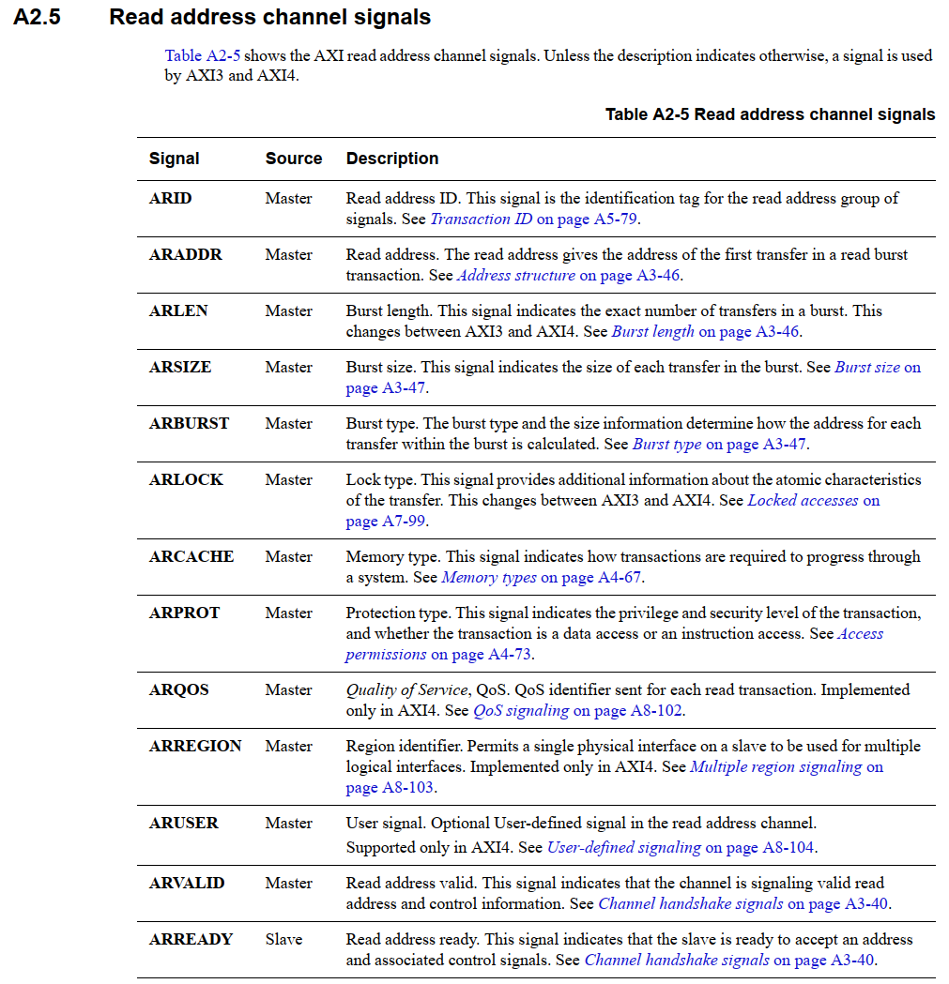
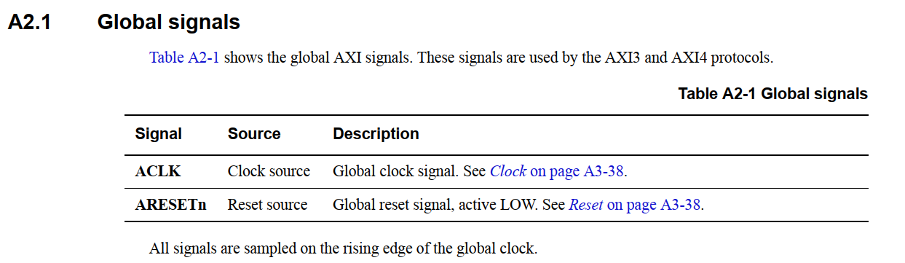
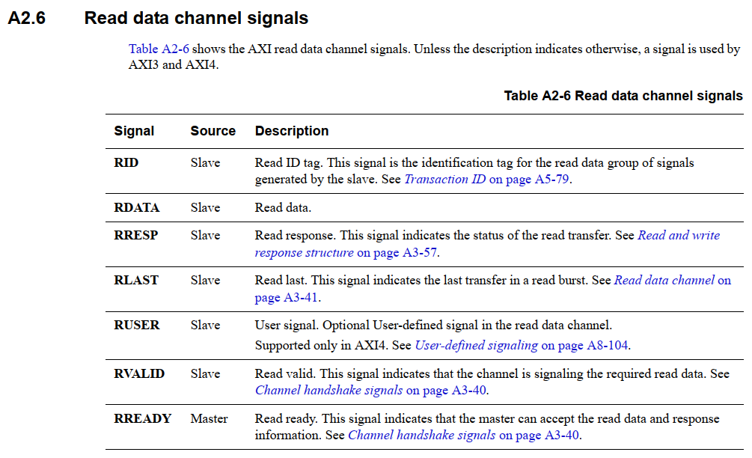
Channel signals

Slide 19
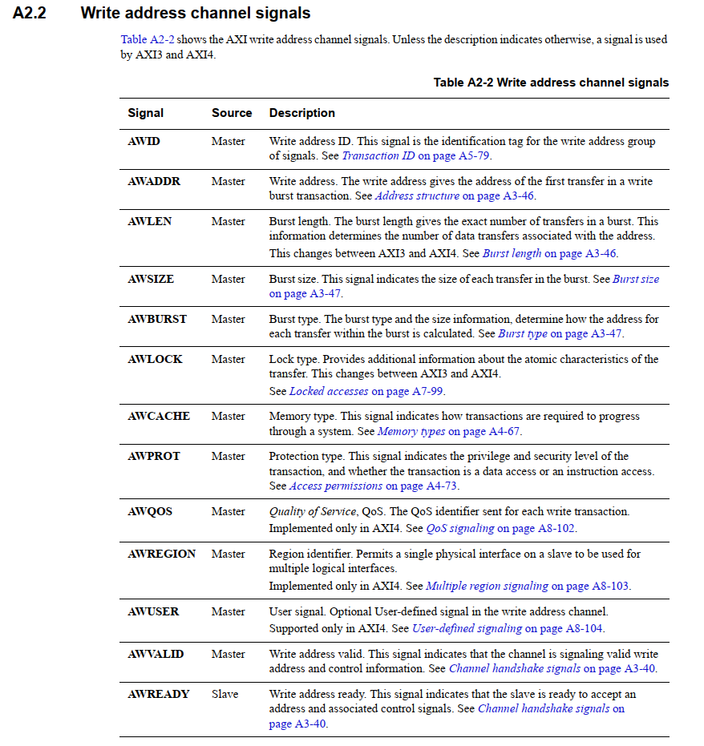
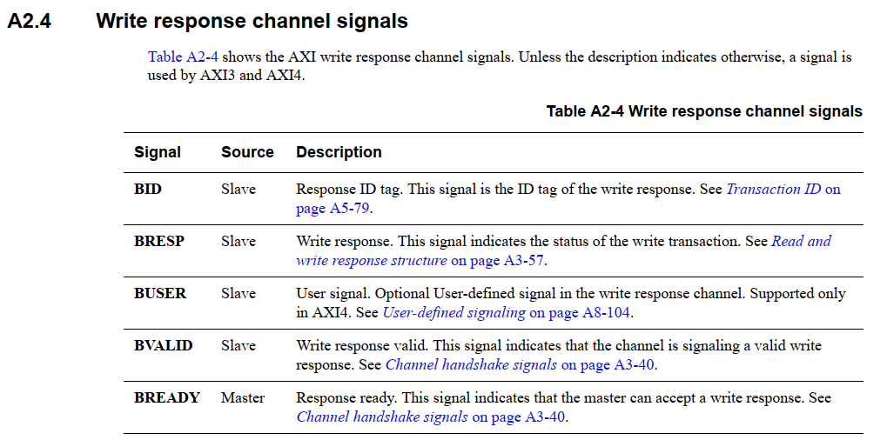
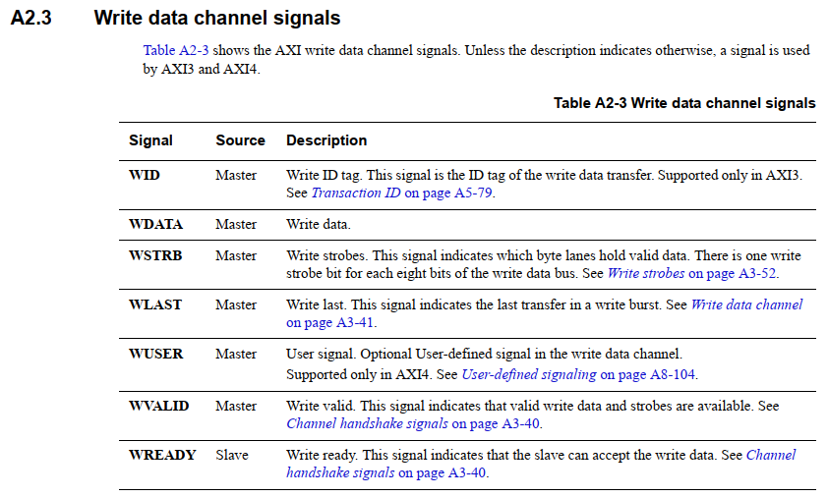
Channel signals

Slide 20
Data size, length, and burst type
AxLEN describes the length of the transaction in the number of transfers.
For AXI3, AxLEN[3:0] has 4 bits, which specifies a range of 1-16 transfers in a transaction.
For AXI4, AxLEN[7:0] has 8 bits, which specifies a range of 1-256 data transfers in a transaction.
AxSize[2:0] describes the maximum number of bytes to transfer in each data transfer. Three bits of encoding indicate 1, 2, 4, 8, 16, 32, 64, or 128 bytes per transfer.
AxBURST[1:0] describes the burst type of the transaction: fixed, incrementing, or wrapping.
Value | Burst type | Usage notes | Length | Alignment
0x00 | FIXED | Reads the same address repeatedly. Useful for FIFOs. | 1-16 | Fixed byte lanes only defined by start address and size.
0x01 | INCR | Incrementing burst. The slave increments the address for each transfer in the burst from the address for the previous transfer. The incremental value depends on the size of the transfer, as defined by the AxSIZE attribute. Useful for block transfers. | AXI3: 1-16 AXI4: 1-256 | Unaligned transfers are supported.
0x10 | WRAP | Wrapping burst. Similar to an incrementing burst, except that if an upper address limit is reached, the address wraps around to a lower address. Commonly used for cache line accesses. | 2, 4, 8, or 16 | The start address must be aligned to the transfer size.
0x11 | RESERVED | Not for use

Slide 21
Response signaling
AXI provides response signaling for both read and write transactions.
For read transactions, the response information from the slave is signaled on the read data channel using RRESP.
For write transactions, the response information is signaled on the write response channel using BRESP.
RRESP and BRESP are both composed of two bits，and the encoding of these signals can transfer four responses
Response code | Description
00 - OKAY | Normal access success or exclusive access failure. OKAY is the response that is used for most transactions. OKAY indicates that a normal access has been successful. This response can also indicate that an exclusive access has failed. An exclusive access is when more than one master can access a slave at once, but these masters cannot access the same memory range.
01 - EXOKAY | Exclusive access okay. EXOKAY indicates that either the read or write portion of an exclusive access has been successful.
10 – SLVERR | Slave error. SLVERR is used when the access has reached the slave successfully, but the slave wants to return an error condition to the originating master. This indicates an unsuccessful transaction. For example, when there is an unsupported transfer size attempted, or a write access attempted to read-only location.
11 - DECERR | Decode error. DECERR is often generated by an interconnect component to indicate that there is no slave at the transaction address.

Slide 22
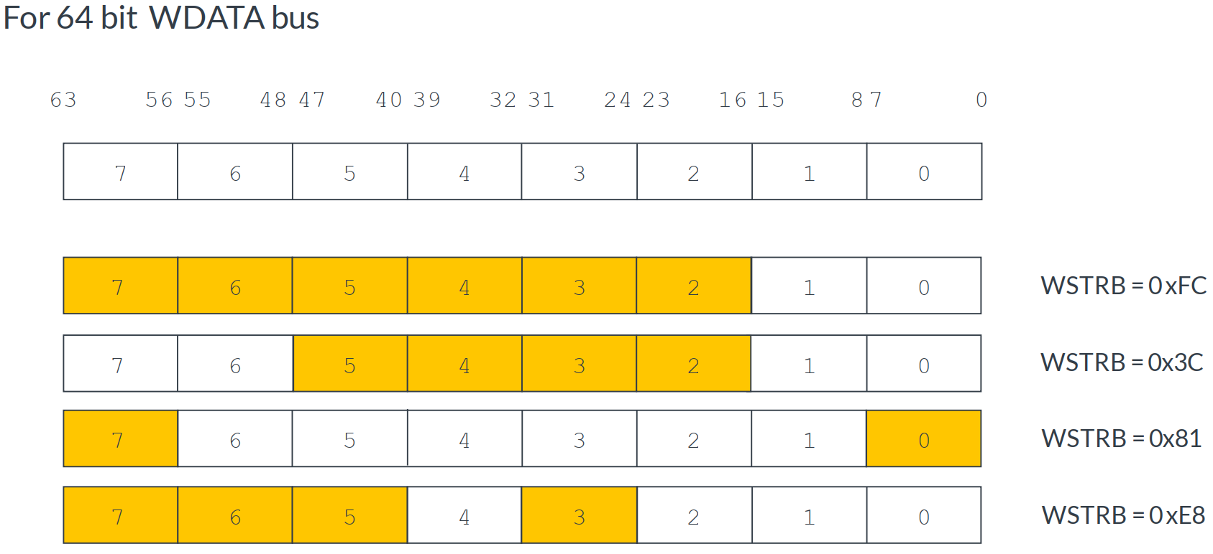
Write data strobes
The write data strobe signal is used by a master to tell a slave which bytes of the data bus are required.
Write data strobes are useful for cache accesses for efficient movement of sparse data arrays.
In addition to using write data strobes, you can optimize data transfers using unaligned start addresses.
Byte lane strobes offer efficient movement of sparse data arrays. Using this method, write transactions can be early terminated by setting the remaining transfer byte lane strobes to 0, although the remaining transfers must still be completed.
The WSTRB signal can also change between transfers in a transaction.

Slide 23
AXI channel dependencies
Three of the main dependencies are as follows:
WLAST transfer must complete before BVALID is asserted.
The master must send all the write data before a write response can be seen by the master.
This dependency does not exist in AXI3 but is introduced for AXI4：
In AXI3, the address does not have to be seen before a write response is sent.
In AXI4, all of the data and the address must have been transferred before the master can see a write response.
RVALID cannot be asserted until ARADDR has been transferred.
The slave cannot transfer any read data without it seeing the address first. This is because the slave cannot send data back to the master if it does not know the address that the data will be read from.
WVALID can assert before AWVALID.
A master could use the Write Data channel to send data to the slave, before communicating the address where the slave should write these data.

Slide 24
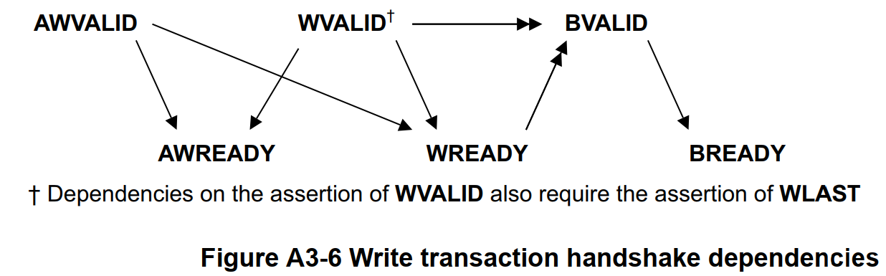
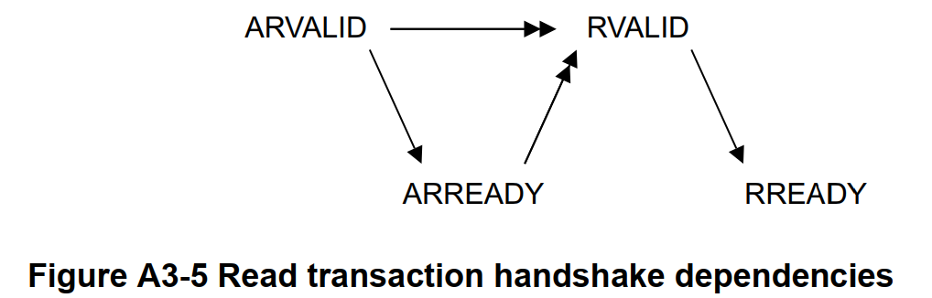
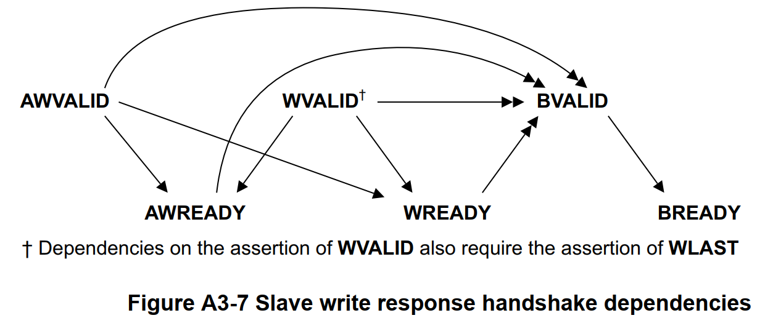
AXI channel dependencies
In the dependency diagrams:
single-headed arrows point to signals that can be asserted before or after the signal at the start of the arrow
double-headed arrows point to signals that must be asserted only after assertion of the signal at the start of the arrow.

Slide 25
Transaction IDs
The AXI protocol defines an ID signals bus for each channel. The ID signal buses are as follows：AWID、WID、BID、ARID、RID
Marking each transaction with an ID gives the possibility to complete transactions out of order. This means that transactions to faster memory regions can complete without waiting for earlier transactions to slower memory regions.
The use of transfer IDs enables the implementation of a high-performance interconnect, maximizing data throughput and system efficiency. This feature can also improve system performance because it reduces the effect of transaction latency
The AXI protocol supports out-of-order transactions by enabling each interface to act as multiple ordered interfaces. According to the AXI protocol specifications, all transactions with a given ID must be ordered. However, there is no restriction on the ordering of transactions with different IDs.
When working with transfer IDs, follow these rules:
All transfers must have an ID.
All transfers in a transaction must have the same ID.
Masters can support multiple IDs for multiple threads.
Slaves generally need a configurable ID width.
You should also remember these two important AXI parameters for ID signals:（interconnect remap）
The write ID width, which is the number of bits used for the AWID, WID and BID buses
The read ID width, which is the number of bits used for the ARID and RID buses

Slide 26
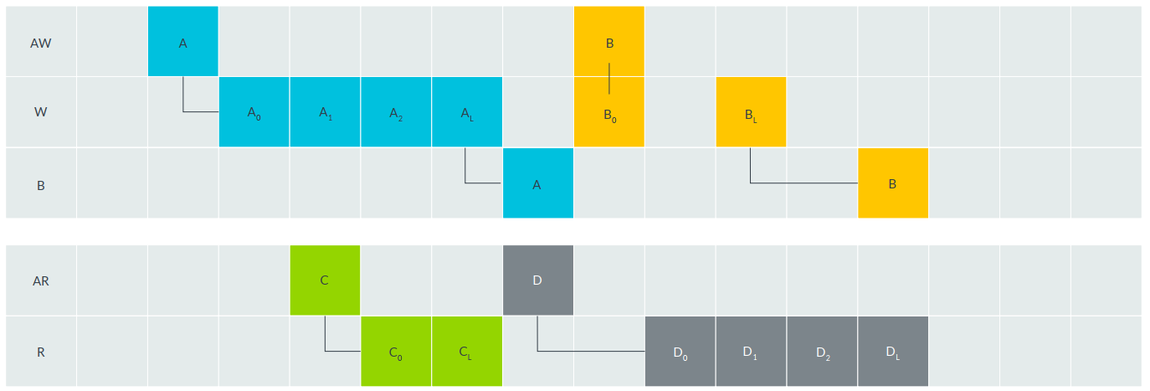
Transactions Example ：outstanding = 1
在写通道上，等到 Transaction A 完成才开始Transaction B。其中Transaction A的请求先被发出，Transaction B的请求和数据被同时发出。
在读通道上，等到 Transaction C 完成才开始Transaction D。读事务的请求必须先于数据发出。

Slide 27
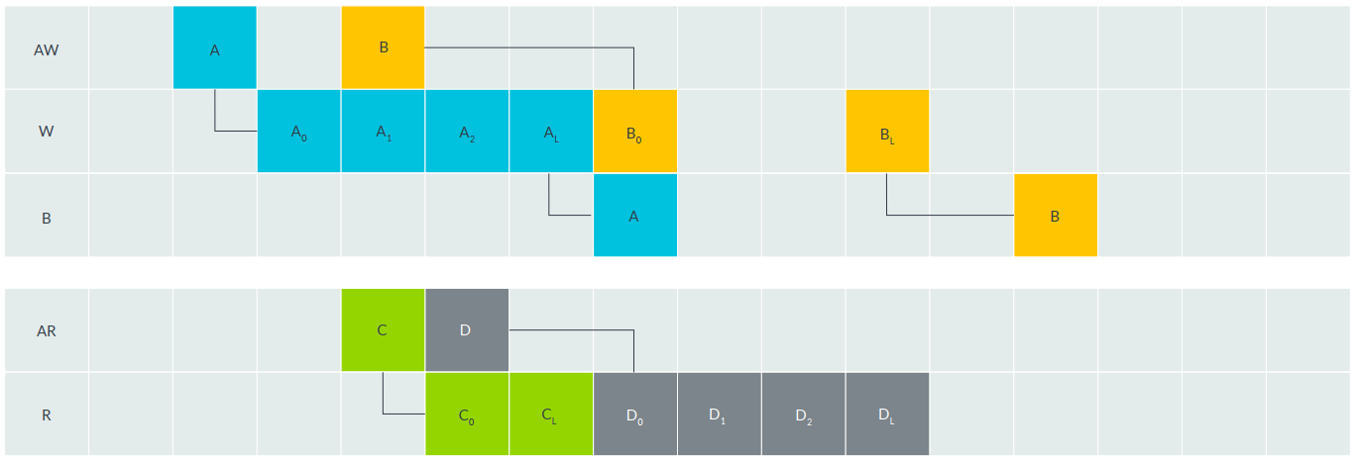
Transactions Example ：outstanding = 2
在写通道上，在Transaction A 尚未完成时就开始Transaction B。提高了W通道的带宽利用率
在读通道上，在Transaction C 尚未完成时就开始Transaction D。提高了R通道的带宽利用率

Slide 28
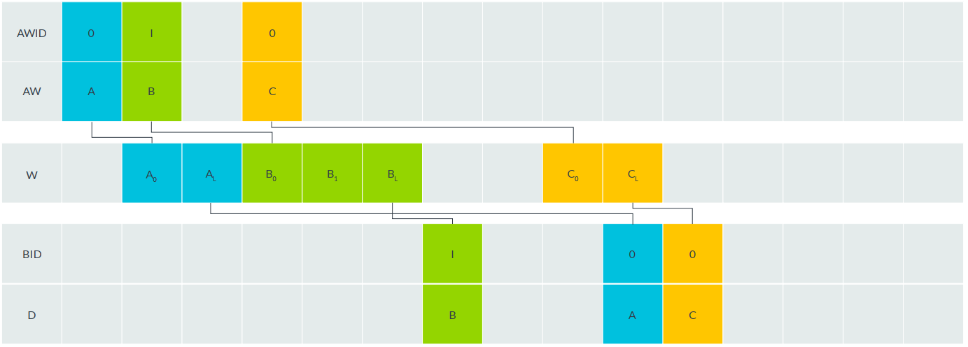
Write transaction ordering rules
写事务A、B、C被依次启动（outstanding >= 3），完成顺序为B、A、C
写通道上仅支持transaction级别的out-of-order

Slide 29
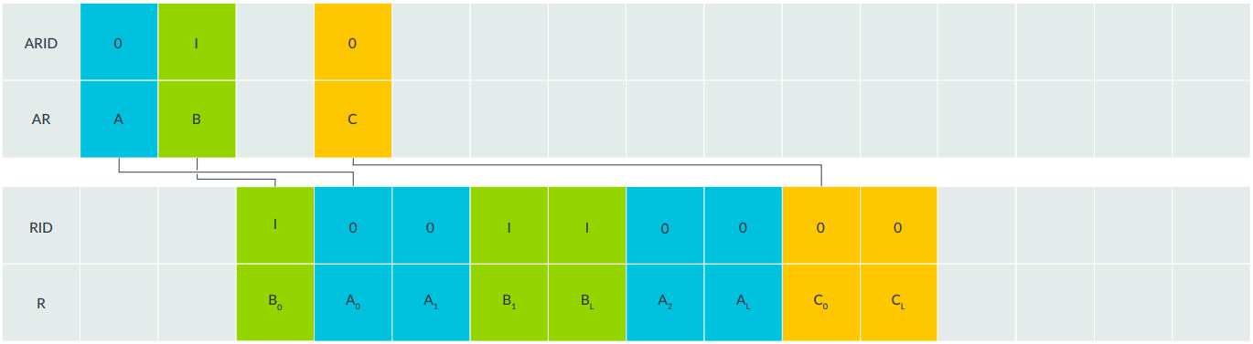
Read transaction ordering rules
读事务A、B、C被依次启动（outstanding >= 3），完成顺序为B、A、C
读通道上不仅支持transaction级别的out-of-order，还支持transfer级别的out-of-order（Interleaving）

Slide 30
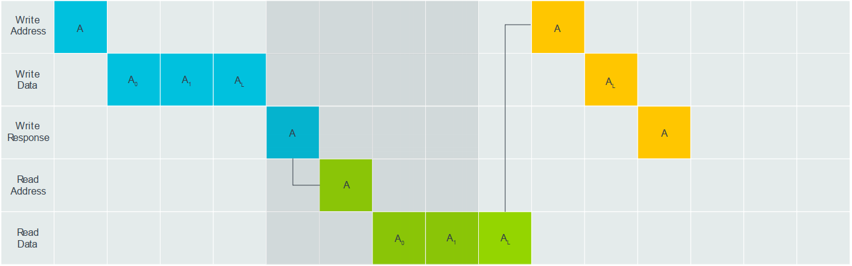
Read and write channel ordering
读通道和写通道之间没有保序规则。
This means that they can complete in any order.
So, if a master requires ordering for a specific sequence of reads and writes, the master must ensure that the transaction order is respected by explicitly waiting for transactions to complete before issuing new ones.

Slide 31
AXI4-Lite

Slide 32
AXI4-Stream

Slide 33
Read and write interface attributes
The write interface attributes include the following:
Write issuing capability: Represents the maximum number of active write transactions the manager interface can generate
Write acceptance capability : Represents the maximum number of active write transactions the subordinate interface can accept
Write interleave capability (AXI3 only): The number of active write transactions for which the manager interface is capable of transmitting data.
Write interleave depth attribute（AXI3 only）: Represents the number of active write transactions that the subordinate interface can receive data from
The read interface attributes include the following:
Read issuing capability attribute: Represents the maximum number of active read transactions that a manager interface can generate
Read acceptance capability: The maximum number of active read transactions that a subordinate interface can accept
Read data reordering depth: The number of active read transactions for which a subordinate interface can transmit data, counted from the earliest transaction

Slide 34
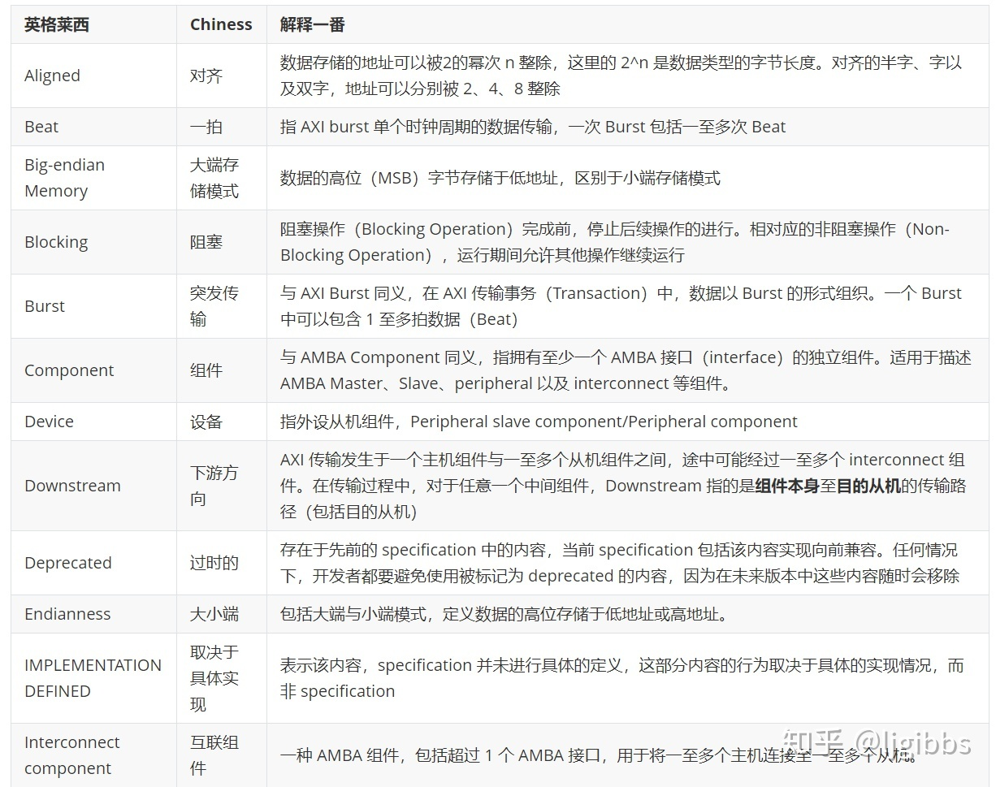
Glossary：参见IHI0022E的附录

Slide 35
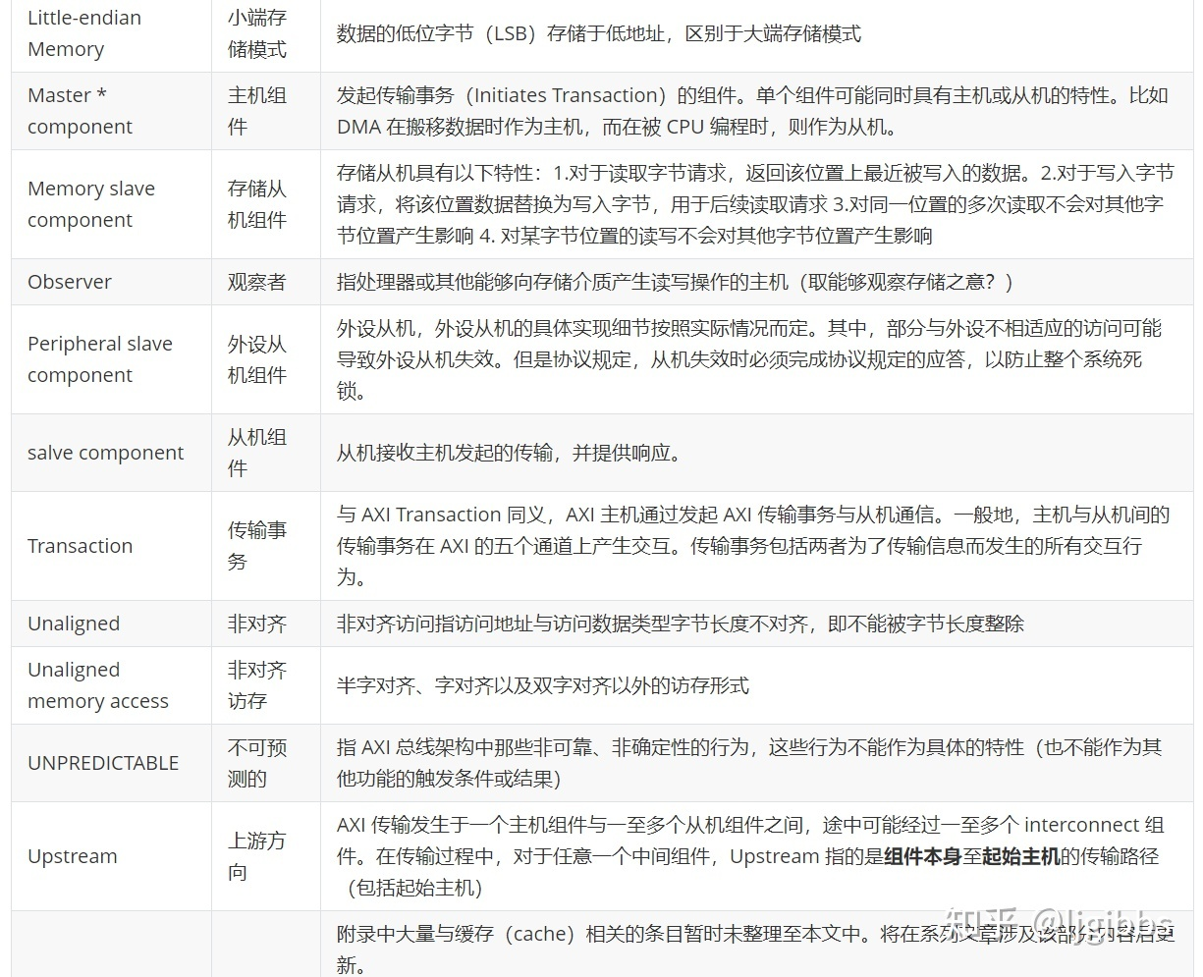
Glossary

Slide 36
Harder Topics
Atomic accesses
Memory types
Access permissions
Ordering model
Low-power interface

Slide 37
参考材料
文档：
Learn the architecture - An introduction to AMBA AXI（Version 3.0）
AMBA AXI and ACE Protocol Spec（ IHI0022E）
AMBA_AXI4_Stream_Protocol_Spec（ IHI0051A）
Vivado-AXI-Reference-Guide（ug1037）
博客：
深入 AXI4 总线（O）专栏目录与资料集合
System-on-Chip bus: AXI4 simplified and explained
Learning AXI: Where to start?
The hard part of building a bursting AXI Master
AXI Interconnects Tutorial: Multiple AXI Masters and Slaves in Digital Logic

Slide 38
进阶学习 AMBA 5 CHI
文档：
Learn the architecture - An introduction to AMBA CHI（Version 1.0）
AMBA CHI Architecture Spec（ IHI0050F）
博客：
AMBA CHI协议导论
AMBA CHI知识分享专题
ARM系列 -- ACE（一）

Slide 39
Thanks
Q&A：

Slide 40
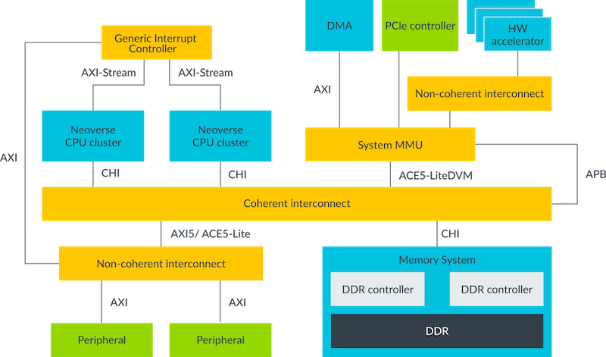
an ABMA based SoC example

Slide 41
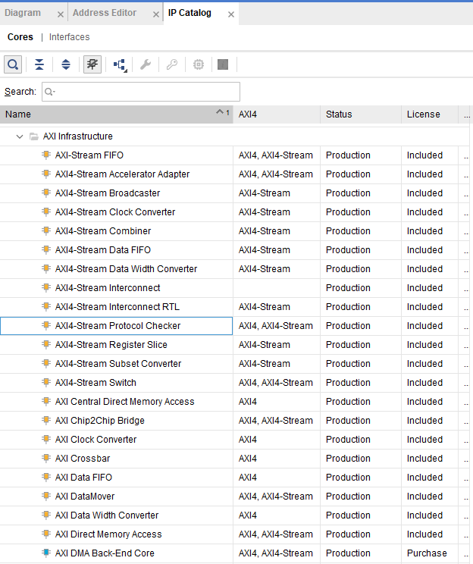
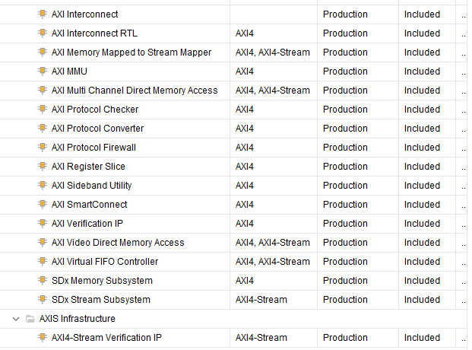
Vivado AXI IP

